Slide 1
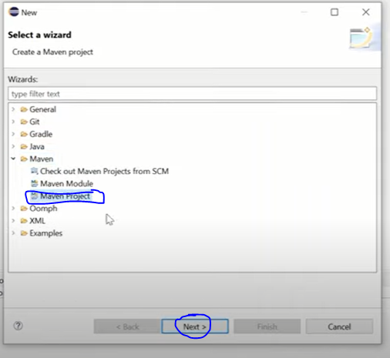
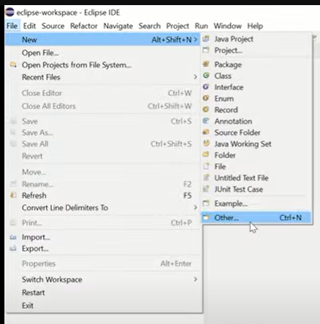
STEPS TO CREATE MAVEN PROJECT
Step 1:-click on the file ->new->others .
Step 2:-click on the maven project and next .

Slide 2
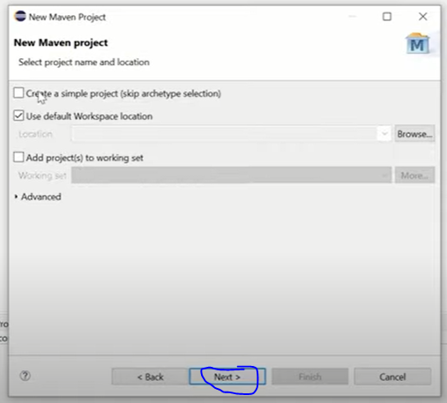
Step 3:- click on the next.

Slide 3
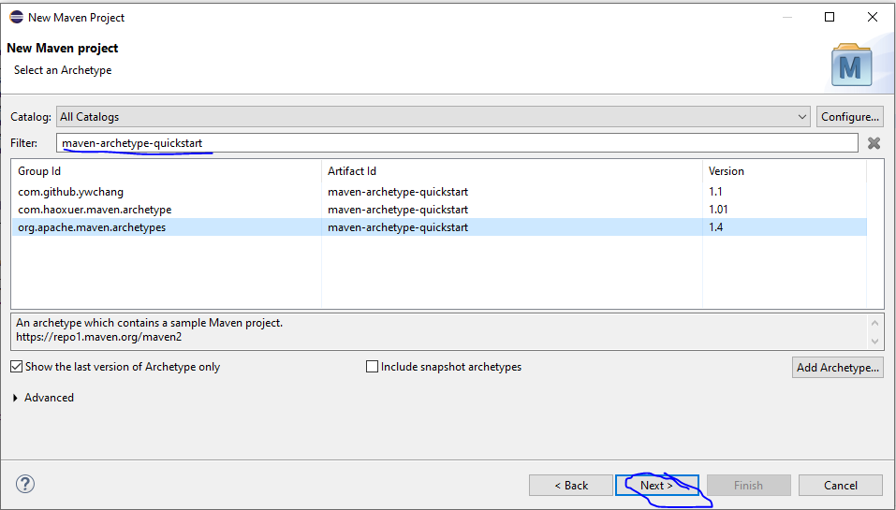
Step 3:- enter the maven-archetype-quickstart in filter field and select the artifact id maven-archetype-quickstart version 1.4
Click on the next.

Slide 4
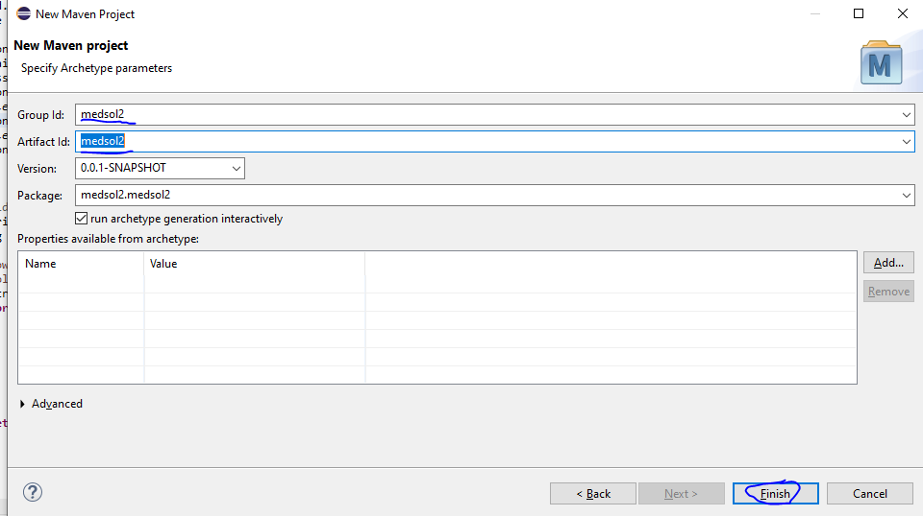
Step 4:- enter the group id and artifact id and click on the finish .

Slide 5
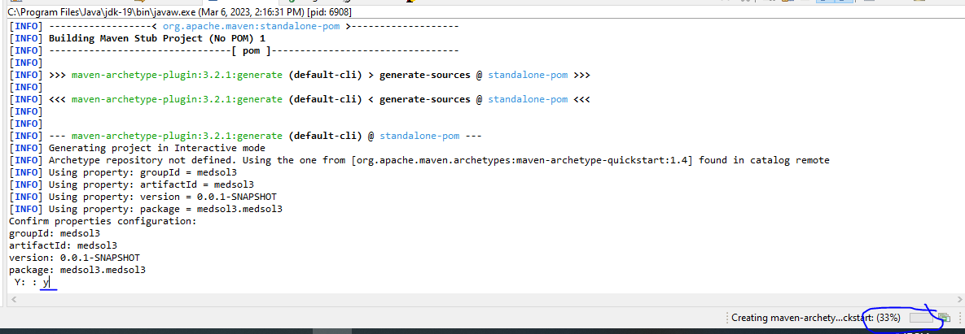
Step 5:- after pressing finish button it start to build maven project and we need to type y in the left corner of the console to confirm properties configuration
Press enter.

Slide 6
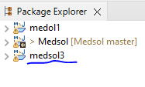
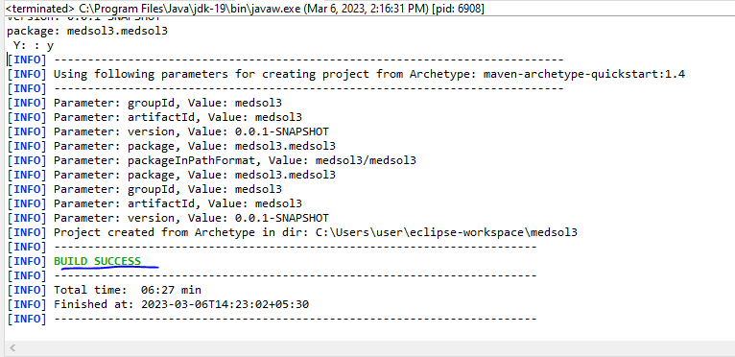
In the package explorer we can see the project name and the build success message in console

